Slide 1
17th session.
Private Equity and Venture Capital
Special thanks to:
Will Price, Hummer Winblad Venture Partners
Ben Holmes, Index Ventures
Venture Capital Junior
Notes:
We will deal with financial topics slowly because, finally, we have to use numbers for things.

Slide 2
What Is Venture Capital?
What venture capitalists do
Raise pools of capital from institutional and individual investors
  Finance new and rapidly growing companies;
  Purchase preferred equity securities and take board positions;
  Add value to the company through active participation;
  Take higher risks with the expectation of higher rewards;
  Have a long-term orientation
  Make money by M&A or IPO liquidity events

Slide 3
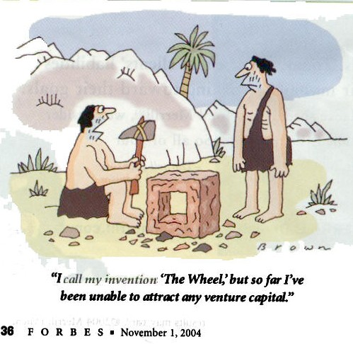
A Long History!

Slide 4
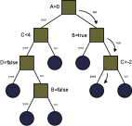
Overview of financing options
Non-Equity Financing
Equity Financing
Angel Financing
Self Finance /
Bootstrapping
Venture Capital
Debt /
Bank Finance
Private Equity
Public
Stock Markets

Slide 5
Self financing / Bootstrapping
Financing growth from previous cashflow and personal funds
Obviously need to have cashflows…
Most good bootstrapped companies emerge from a service or consulting companies that are productising their offering
Pros
  Bootstrapped companies almost always spend cash more effectively than equity financed companies
  Already being close to existing customers, give excellent ability to understand problems and define good solutions
Cons
  Resources for product and market dev constrained by cashflows
  May miss a big opportunity if other players raise finance and invest heavily

Slide 6
Debt / bank finance
Relatively limited funds will be available; likely to want security anyway
Banks only lend to predictable businesses they can understand
If your capital requirements are limited and your business is following a well trodden path, can be a useful source of finance
Not particularly useful web or high growth tech industries

Slide 7
Good reasons to raise Equity finance
Pre-requisites
Unique Product
Or Concept
Passionate
Founding Team
Large Potential
Market Opportunity
Implications…
Need to move
rapidly
Intense
competition
likely
VC funding supports
Hiring
Rapid Product
Development
Partnerships
Infrastructure
Internationalisation
Commercialisation

Slide 8
When not to raise VC
Application
is a feature
not a product
Market size is
too small
Motivation is
not financial
Risk is not that you waste time unsuccessfully trying to raise finance …
… real danger is that you do succeed in raising VC funds
  Lose opportunity for small exit which could be personally lucrative
  Lose opportunity to run lifestyle business
  Get bound in to 3+ yrs work you may not enjoy

Slide 9
Flavors of VCs
Different segments of VC
Sector
    Healthcare versus IT versus clean energy
  Size
    Mini fund (<$ 15M) Small fund (<$100M) to large fund (>$1B+)
  Geography
    US, EU, India, Israel, ...
  Stage
    Seed/early – two guys and an idea/demo
    Mid-Stage – initial revenue traction
    Late-Stage – near breakeven – expansion/mezzanine capital

Slide 10
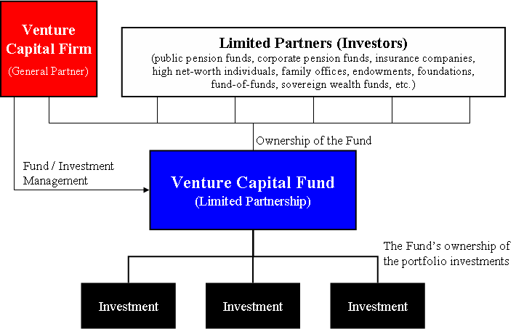
Structure of a VC firm
4
Source: http://en.wikipedia.org/wiki/Image:Venture_Capital_Fund_Diagram.png

Slide 11
VC funding stages
Seed Money: Low level financing needed to prove a new idea (Often provided by "angel investors")
Start-up: Early stage firms that need funding for expenses associated with marketing and product development
First-Round: Early sales and manufacturing funds
Second-Round: Working capital for early stage companies that are selling product, but not yet turning a profit
Third-Round: Also called Mezzanine financing, this is expansion money for a newly profitable company
Fourth-Round: Also called bridge financing, 4th round is intended to finance the going public process
5

Slide 12
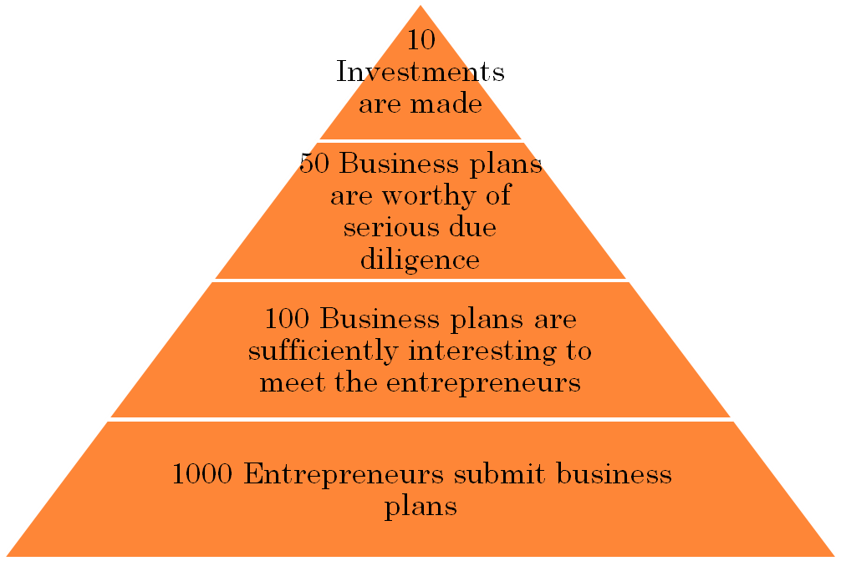
VENTURE SELECTION PROCESS
VC pyramid
Sponsored Support Services
8. Venture capital fund (s)
7. Local business advisors
6. Consultants
5. University or laboratory
participation
4. Seminars
3. Luncheon or dinner club
2. Newsletter
1. Incubator
6

Slide 13
VC selection process
Fund’s Pre-determined Criteria
At what stage is the company?
What problem is the company attempting to solve?
Is its solution proprietary or conveyed to the problem in a unique way?
Is the entrepreneurial team experienced and competent to manage a rapidly emerging company?
Has the company, its product or solution or its management team, been endorsed by a responsible and highly regarded customer or investor?
How much capital is required?
7
Source: Silver, A. David. Venture Capital, 1985.

Slide 14
VC selection process
First Law. Risk Aversion: “Accept no more than two risks per investment.”
The Development Risk: Can we develop the product?
The Manufacturing Risk: If we can develop it, can we produce it?
The Marketing Risk: If we can make it, can we sell it?
The Management Risk: If we can sell it, can we sell it at a profit?
The Growth Risk: If we can manage the company, can we grow it?
8

Slide 15
VC selection process
Second Law. Valuation: “V = P x S x E, where
V = valuation, P = problem, S = solution, and E = entrepreneurial team.”
Third Law. Law of the Big-P: “Invest in big P companies, because the public market will accord to them unreasonably high V’s, irrespective of S and E.”
The Audit of P.
The Audit of S.
The Audit of E.
The Financial Statement Audit.
The Legal Audit.
9
Source: Silver, A. David. Venture Capital, 1985.

Slide 16
VC selection process
Other Due Diligence
Background checks on the management team
Independent verifications of statements made in the business plan
Studies of the company’s product and market
Interviewing management and other company personnel
Talk to suppliers, customers, competitors, etc.
10
Source: Silver, A. David. Venture Capital, 1985.

Slide 17
How does VC work
General Partners
  6-8 active deals at a time
Principals/Associate
  Drive deal flow, deal process, and portfolio company development
Finance, Marketing, and HR Staff
Limited Partners
Actually investing money
Decision Making
  Typically unanimous
  Individual partners champion deals to group
  Deal team diligences prospect and builds investment case
  Partnership acts as a check and balance to ensure careful decision making

Slide 18

How the VC's make money
Raise fund every 2-4 years
  Pension funds, financial institutions and specialist “fund of fund” investors
Invest money over 3-5 years
1/2 of investments lose money
1/3 of investments break even
1/6 of investments make (lots) of money

Slide 19
Economics of VC Firm
Tipical fees in VC
Management Fees (typically 2-2.5% of AUM)
  Charge a management fee to cover the costs of managing the committed capital.
Carried Interest (typically 20-25%)
  "Carried interest" is the term used to denote the profit split of proceeds to the general partner.
Example $100m fund
  4x return and 2 and 20%
  $2m per year in management fee
  (($100m x 4) - $100m) * 20% = $60m in carried interest

Slide 20
Types of investments for VC's
Ordinary Share investment
  Simplest form, often used by angels
  All shareholders have similar rights
  Company Board composed according to
Convertible Loan
  Sometimes used by both Angels and VCs
  Typically when another financing is anticipated soon
  Loan will convert (with a discount ~25%) into the next financing round
Preferred Share Investment
  Typical Structure used by VCs and occasionally larger Angels investing as a group

Slide 21
What do VC’s want
Early stage focus issues
This depends on stage – let’s focus on early stage since that is what we do.
  Team
    Domain expertise with core technical strength and knowledge of given market opportunity
    History of collaboration and success
    A willingness to allow VC’s to help build the team
  Market
    Emerging and fast growing market
    Bad markets make for bad companies
  Business model
    How will you make money, how will you sell
  Technology
    Defensible technology/IP that can be protected to form competitive barriers over time

Slide 22
Presenting to VC's. Your Pitch: 10 slides
What we do
Who we are
How we plan to make money
What we are asking for (how much money)
Demo
Secret Sauce/Technology/Real Innovation
Market Analysis
Competitive Assessment
Go to Market
Business Model/Financials/Targeted Milestones
The audience must know in the first minute what you do
or they will tune out

Slide 23
Presenting to VC's. Your Pitch: 10 slides
Be honest with yourself about the risks / unknowns
  Do you really want to do it?
  Do customers want the product / service?
  Do you have the competence to build the product and the team
  Can you monetise the product / service?
  How competitive is / will the space be?
  How big can the overall market become?

Slide 24
What to Expect
Looking for finance in the VC world
Choosing the right VC firm
Choosing the right contact person
Gettting in touch
12-16 week process
  First meeting to close
  1st mtg → diligence → partner meeting → TS negotiation → close
Prepare Investor Package
  Presentation
  Financial Plan
  Personal references
  Customer references
  Market references
  Cap Table
  Market research
  Product documentation
  Competitive Analysis
Investors will seek:
  20-50% of the company
  Valuation function of targeted raise, ownership, and stage,
  Preferred Equity securities, with key terms:
    BoD seat
    Liquidation Preference
    Anti-dilution Protection
    Participation
    Pro Rata rights
    Protective Provisions
    Vesting terms for founders and employees

Slide 25
What to Consider
Considering when approaching VC firms
Is the idea sufficiently baked?
  Optimal time is 6 months of iteration
Pick your co-founders very carefully
Test fit with VC
  Personality, values, knowledge of market
Optimize for best deal not best price
Consider the downstream effects of the financing
  High-post moneys can by Pyrrhic victories if company misfires
  Angel financing can be a mixed blessing – be careful

Slide 26
Approaching VC’s
Considering when approaching VC firms
Investing is a people business, and getting a meeting is all about “who you know”
Best way to approach a VC is some form of introduction
  If you don’t know a VC, find someone who knows you who does and get them to introduce you
  Entrepreneur, professor, attorney…
  Sending a plan to info@vcfirmname.com is a waste of time

Slide 27
Tips
Considering when approaching VC firms
Don’t take rejection personally, the odds are against you.
Every VC is “interested” – force them to do work to test their level of interest.
Don’t waste time trying to change the mind of someone who says “no”.
Don’t shop to multiple partners in a firm if the first rejects you.
Don’t ignore the junior partners – they can really help.
There are lots of VC firms, focus on a firm that has some connection to you.

Slide 28
What a good VC will add
Advice and Strategy
Hiring
  Developers
  Country Managers
  Sales
  CEO / CFO / COO
  Advisory Board
Partnerships
Profile and PR
Further access to capital
Internationalisation
Trusted service provider relationships
  Search / recruiting
  Branding / PR
  Finance, etc
Exit optimisation
  Knowledge / contacts with relevant buyers
  Experience with process

Slide 29



VC Tipical deal terms
but that’s so unfair…
Board Representation
Liquidation Preference
Participation rights
Anti-dilution rights
Element of reverse vesting
Certain control and veto rights
Period of exclusivity to close legals
Photo Source: Philip Greenspun, MIT

Slide 30
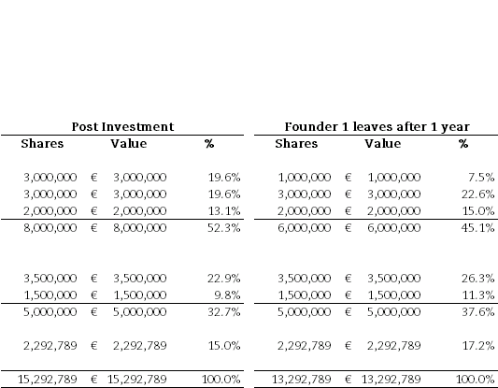
VC: Reverse Vesting
The value of startup is typically in the promise of future labour from the founders
Investors seek to secure this by reverse vesting founder stock, typically over 3 or 4 years
For startups typically all founder stock is subject to reverse vesting.
For later stage companies perhaps half the stock might be subject to vesting
RV also protects founders from each other

Slide 31
Business Angels
Unlike the VC the Angel invests their own money
Much smaller absolute returns can be very meaningful to an angel
The Angel approach is to invest small amounts at a very early stage / low valuation
    €50-€250k at valuations of €500k-€4m
Two “exits” for angel
    Firm might be sold quickly for €5-10m or less where the Angel can make 2-5x money
    Firm raises VC money, after which Angel typically becomes more passive but has built up exposure very cheaply to a venture backed enterprise
The key thing when selecting an Angel therefore is whether they can help you raise VC finance
    See which Angel investors have invested with which VCs

Slide 32
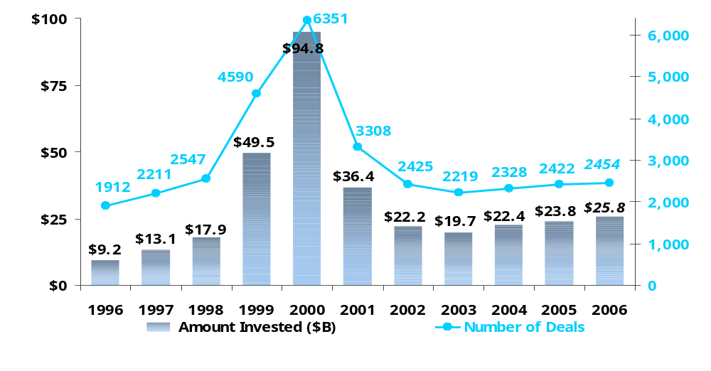
Deal Flow and Equity into VC backed Companies. US 1996-2006
Amount Invested ($B)
Number of Deals
Source: Dow Jones VentureOne/Ernst &Young

Slide 33
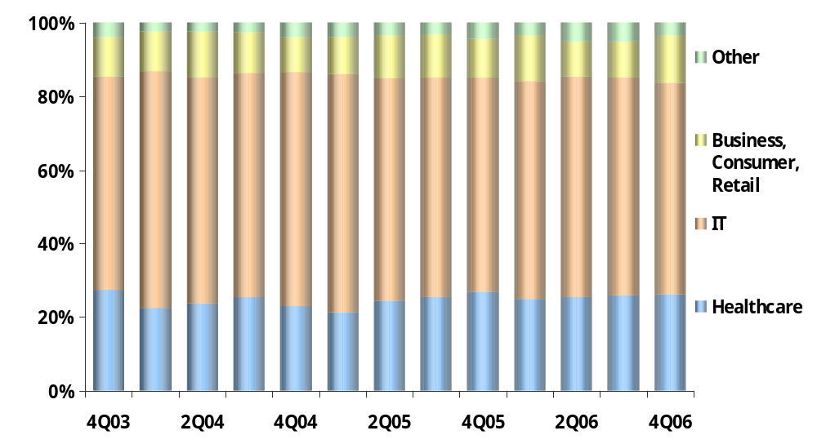
Deal flow allocation by industry 2003-2006 USA
4%
5%
3%
11%
13%
13%
10%
58%
57%
61%
% of Total VC Rounds
27%
23%
26%
Source: Dow Jones VentureOne/Ernst &Young

